Slide 1

Deep Learning-based Multi-modal Depression Estimation using Knowledge from Micro-facial Expressions & Audio & Text
Bachelor Thesis Final Talk – Ping-Cheng Wei
Supervisor: M.Sc. Kunyu Peng, Dr. Alina Roitberg
Referent: Prof. Michael Heizmann
Prof. Rainer Stiefelhagen

Slide 2
Contents
Motivation
Related Work
Dataset Introduction
Model
Experiment
Conclusion
Bibliography
Appendix
Notes:
Overview of this presentation
Start with motivation, related work
Introduce the depression dataset, potential problem
Dive deep into model and experiments, which includes results, ablation studies, and comparison of SOTA

Slide 3
Motivation
Worldwide leading cause of disability
More than 280 million people in the world have depression [1]
In Germany, 10.9% of the population suffers from depression [2, 3]
Major depressive disorder (MDD) leads to suicide
Worldwide, 700,000 people commit suicide due to MDD [1]
In Germany, 15% of patients with MDD die from suicide and about 60% of all suicides are due to depression [2]
Underlying issues:
Hard to detect or even got ignored (33% of patients with depression are not recognized [2])
Confused with other illnesses due to the similar symptoms
Limitations and barriers to effective care, including financial cost, a lack of resources or well-trained experts, and social stigma
Notes:
Well-known that … according to the researches from WHO and german research institutes
If get more severe and severe, serious
Can‘t receive a timely diagnosis and treatment

Slide 4
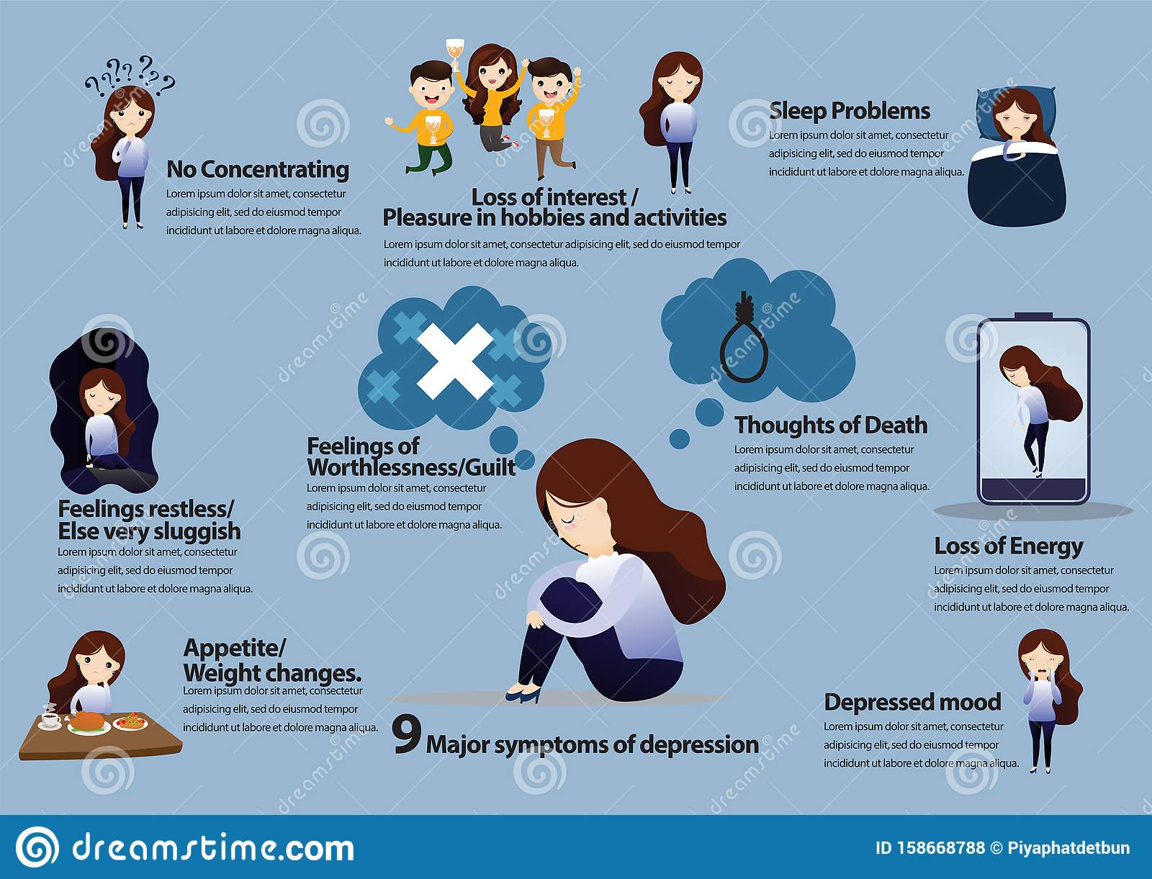
Objective
Automatic depression estimation through multi-modal deep learning-based approach
Exploring the possibilities for leveraging multi- modal data to harvest deeper underlying depression cues
Proving the applicability of utilizing micro-facial expressions for depression detection
Facial key points and gaze direction
Researching the most effective and low-memory cost backbone, fusion method
Corresponding to our GT [4]
Notes:
Therefore, the objective …
Specifically, apply multimodality approch
As shown in image, symptons
That why multi-modal model – yieds deeper underlying cues

Slide 5
Related Work
Statistical ML [5, 6, 7]
Head motion, head position/rotation, blink rate, prosodic features(F0), spectral features (MFCC), word frequency
Trained with SVM
CV techniques [8, 9]
Facial images, facial key points, spectrogram, mel spectrogram
Exploiting C-CNN or CNN model as feature extractor
Natural Language Processing (NLP) [10, 11]
raw audio signal, spectrogram, mel spectrogram, raw text
Trained with LSTM, BiLSTM, Transformer models
Mix of multiple methods [12, 13]
Single modality: combination of CNN and SVM
Multimodality: CNN for audio data + Transformer for text data + late fusion

Slide 6
Depression Dataset – Introduction
DAIC‑WOZ depression database from USC Institute of Creative Technologies [14]
DAIC: Distress Analysis Interview Corpus
WOZ: Wizard of Oz, interact with virtual interviewer (Ellie) controlled by human interviewer
Includes 189 sessions (IDs: 300 – 492)
Train-set (107), Development-set (35), Test-set (47)
Recorded data over each interview
GT: PHQ-8 system
Visual data: 68 3D facial key points + Gaze direction
Audio data: Raw audio signal
Text data: Transcription of the conversation
In all our experiments [5, 7, 10, 13, 15]
Training dataset = Train-set + Development-set
Test dataset = Test-set
Only the features from each Participant are extracted
[14]
Notes:
System score that evaluate the severity of depression
Visual data, which provides information micro-facial experssion
Standard system for evaluating the severity of depression

Slide 7
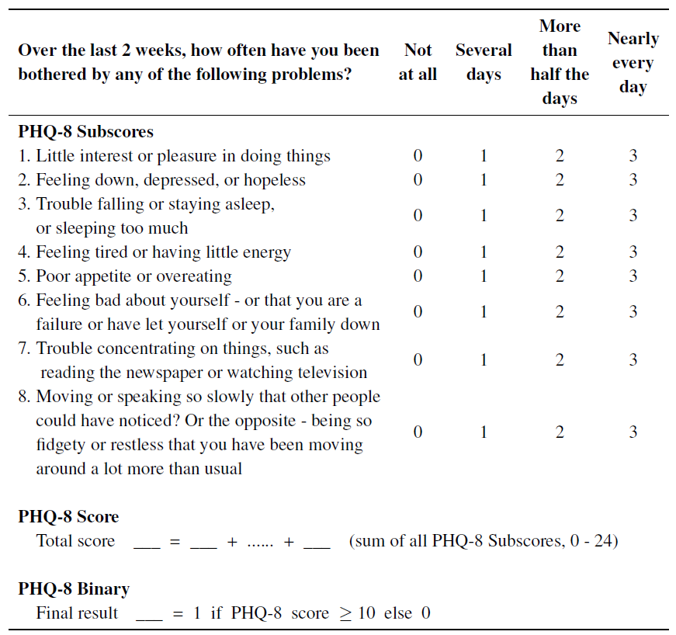

Depression Dataset – PHQ-8 System
PHQ-8 Subscores
No Interest | Depressed | Sleep | Tired
2 | 2 | 3 | 1
Appetite | Failure | Concentrating | Moving
1 | 1 | 3 | 0
PHQ-8 Score
13
PHQ-8 Binary
1
In this work
PHQ-8 Subscores were utilized
Regarding as classification problem
Notes:
Fundamental score: PHQ-8 Subscores
8 classes, corresponds to 8 major depression symptoms
After interview, these subscores will be given and summed up
10, Threshold by definition
Lots of score, classification/regression problem
PHQ-8 Subscores as predicted score

Slide 8
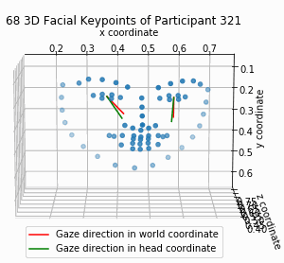
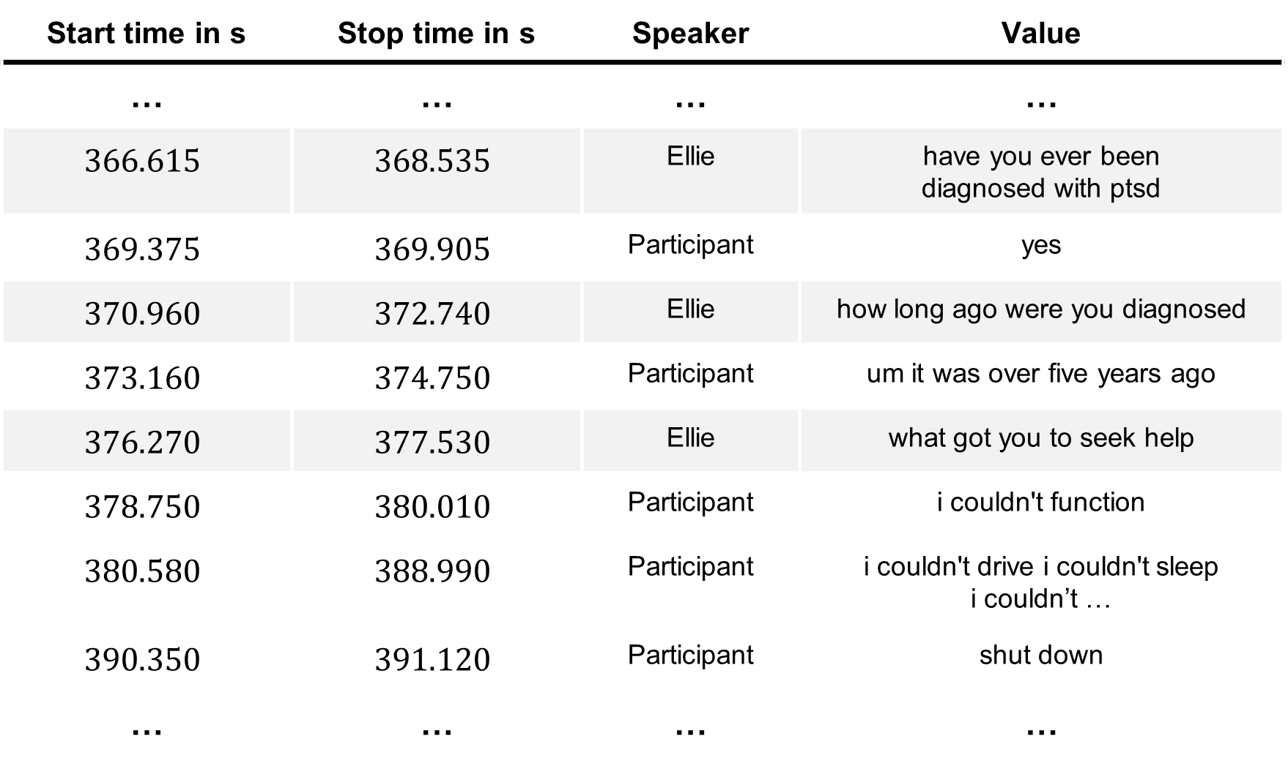
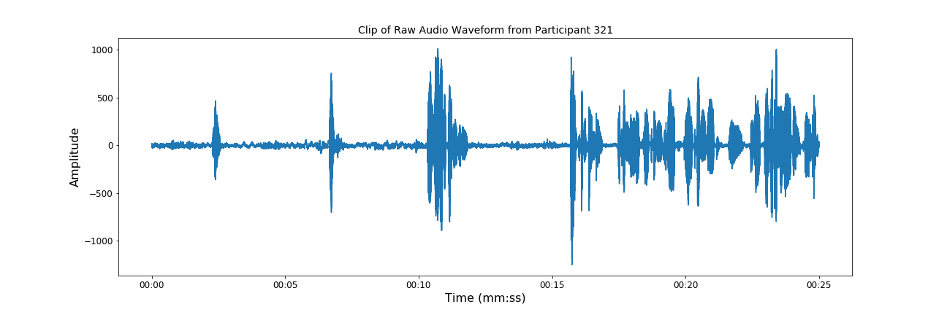
Depression Dataset – Visualization
Notes:
Video of micro-facial expression
Video has been speeded up 5 times -> Change of fkps is even more subtle
Conversation transcribed at here with timestamps and speaker
Possibly silence-suppressed
Agent record the voice from participant

Slide 9
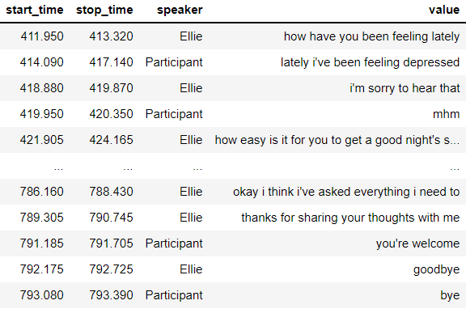
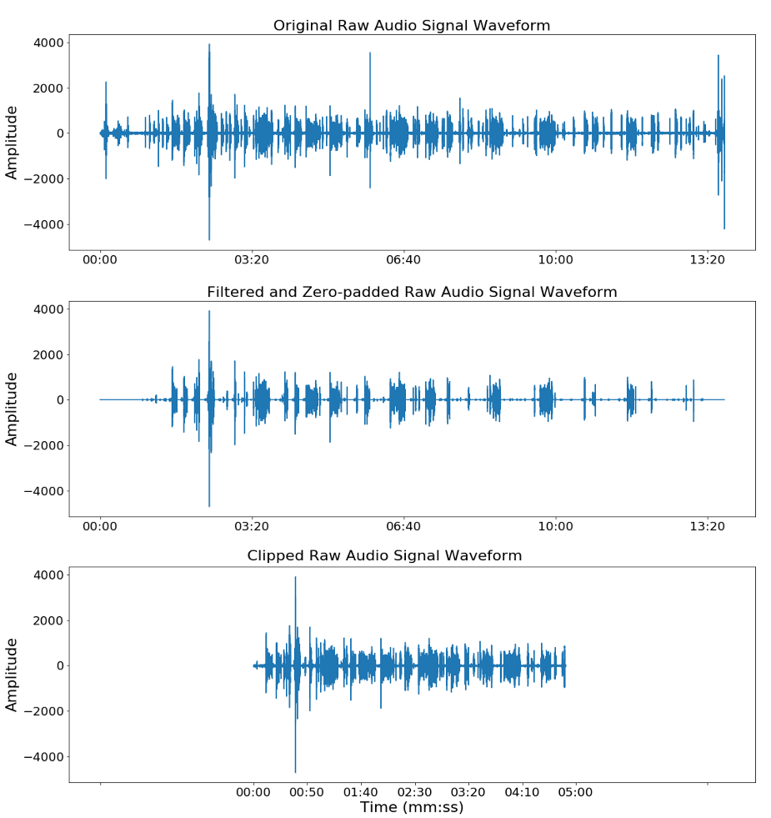
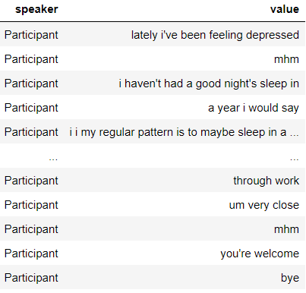
Depression Dataset – Preprocessing
start-stop time pair
Notes:
However raw audio signal are still too noisy and less effective to use

Slide 10
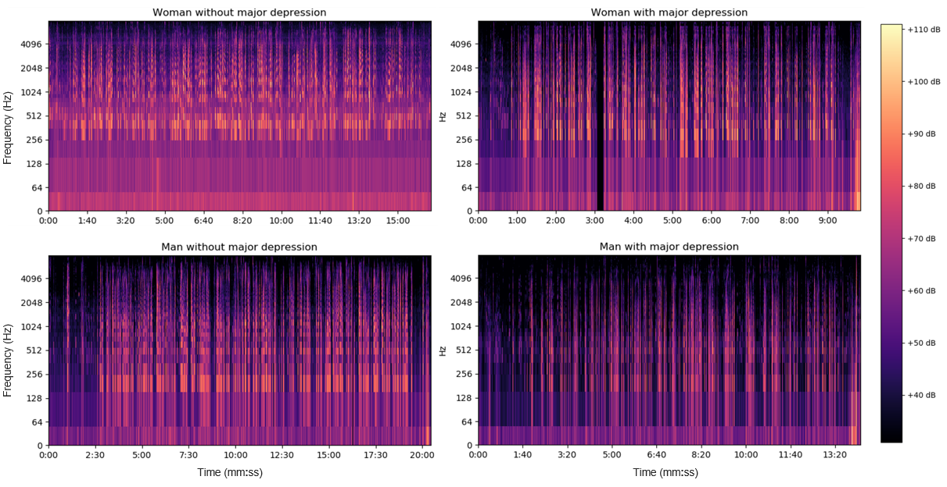
Depression Dataset – Audio Data
Transform raw audio signal to more informative data format → Mel spectrogram
Exploiting online software tool [17] to convert a voice to contrary gender for gender balancing and generating a new audio dataset

Slide 11
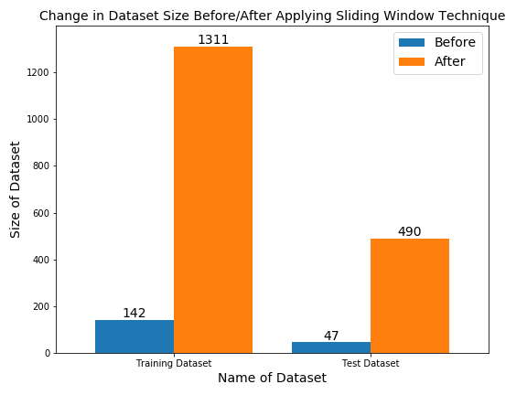
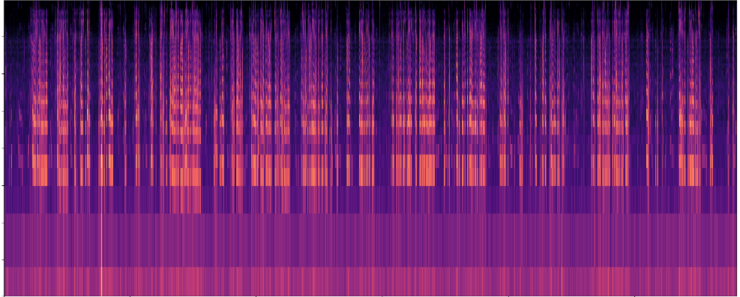
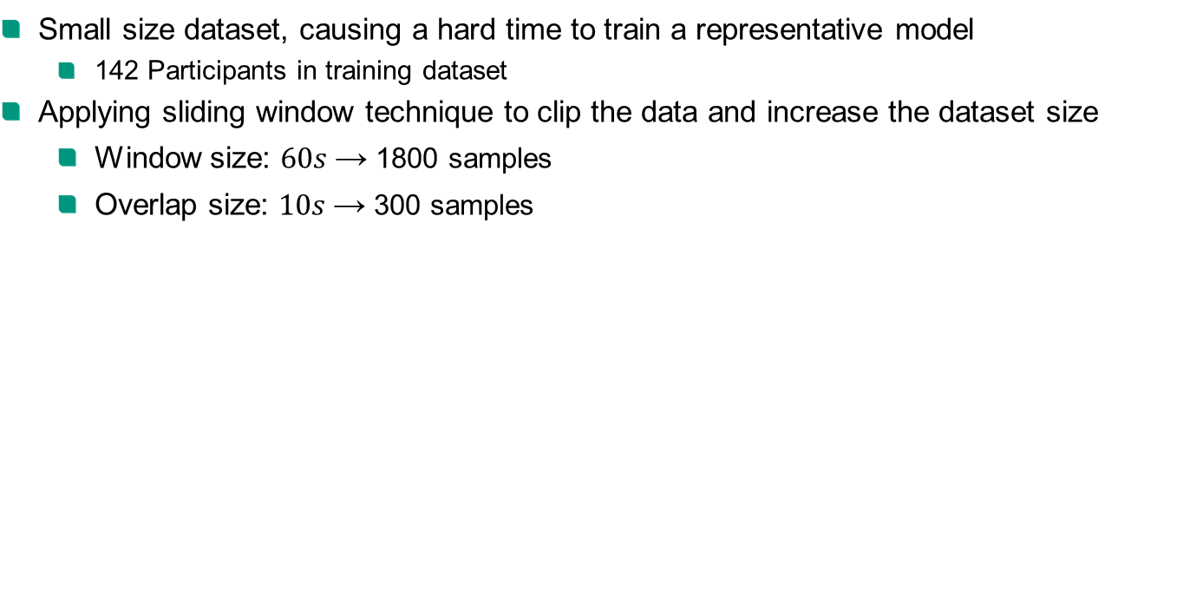
Depression Dataset – Potential Problems
Small size dataset, causing a hard time to train a representative model
142 Participants in training dataset
Applying sliding window technique to clip the data and increase the dataset size
Window size: $60s$→ 1800 samples
Overlap size: $10s$→ 300 samples

Slide 12
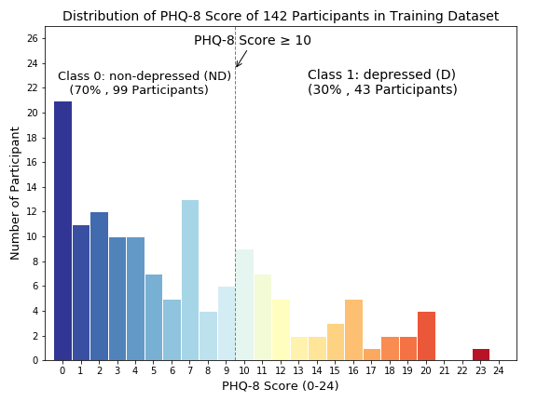
Depression Dataset – Potential Problems
Imbalance dataset between non-depressed and depressed participants
Utilizing weighted random sampler in PyTorch to equally load the data from each class
Applying weighted loss function
Training | Female (F) | Male (M) | Total F+M
ND | 39 (28%) | 60 (42%) | 99 (70%)
D | 24 (17%) | 19 (13%) | 43 (30%)
Total ND+D | 63 (45%) | 79 (55%) | 142 (100%)
Notes:
it is tilted to one side and points downward to the right

Slide 13
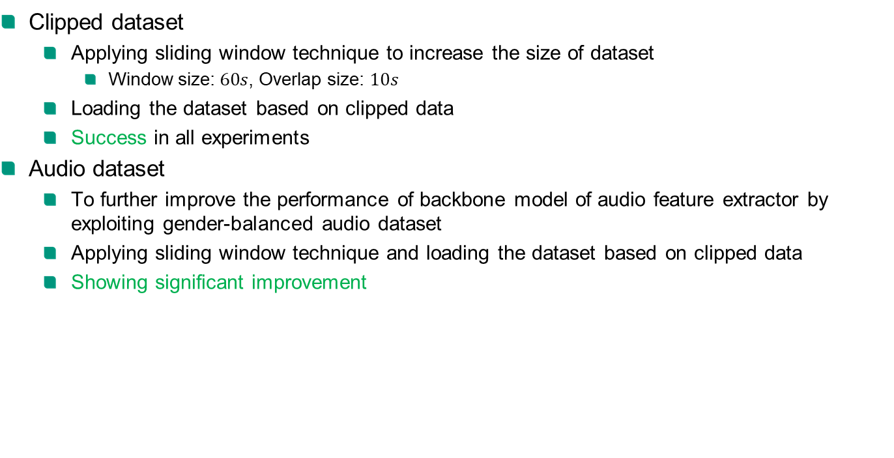
Dataset Generation
Clipped dataset
Applying sliding window technique to increase the size of dataset
Window size: $60s$, Overlap size: $10s$
Loading the dataset based on clipped data
Success in all experiments
Audio dataset
To further improve the performance of backbone model of audio feature extractor by exploiting gender-balanced audio dataset
Applying sliding window technique and loading the dataset based on clipped data
Showing significant improvement

Slide 14
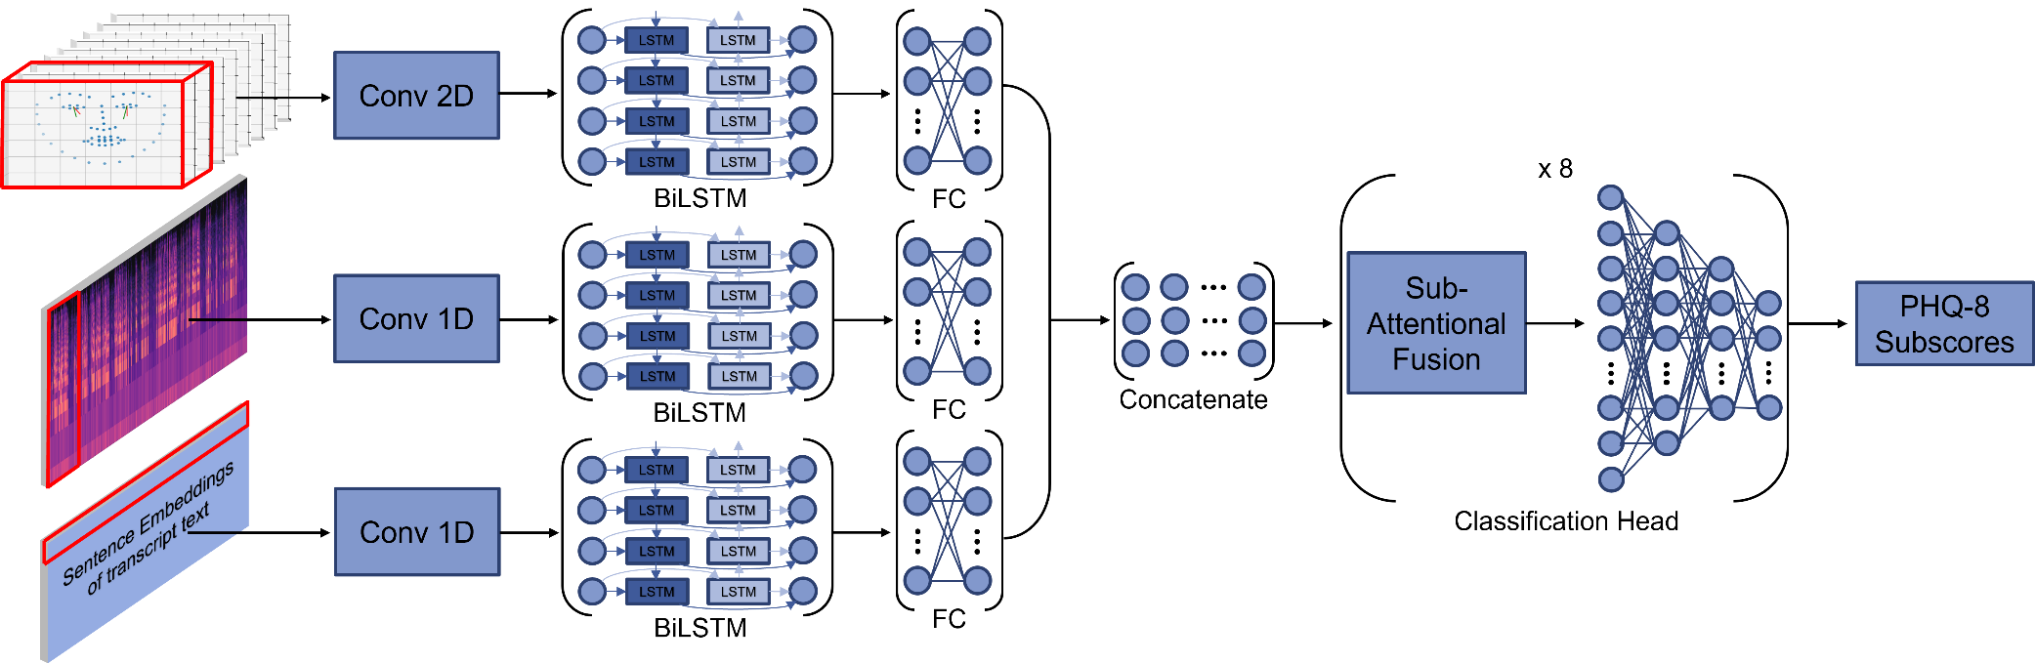
Model – Sub-Attentional ConvBiLSTM
Model backbone based on “DepAudioNet” [10]
Convolution layer + BiLSTM layer + FC layer as feature extractor
Late fusion with 8 different attentional fusion layers → Sub-Attentional Fusion
Predicting the PHQ-Subscores by utilizing 8 classification heads
Calculating the final PHQ-8 Score and PHQ-8 Binary of MDD according to definition

Slide 15

Model – Attentional ConvBiLSTM
Shifting fusion layer out of classification head
Only one attentional fusion layer for late fusion → Attentional Fusion

Slide 16
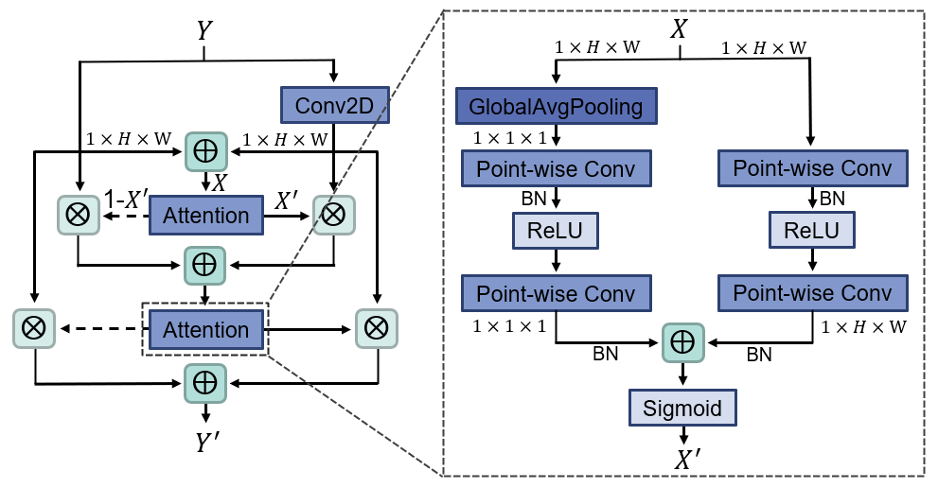
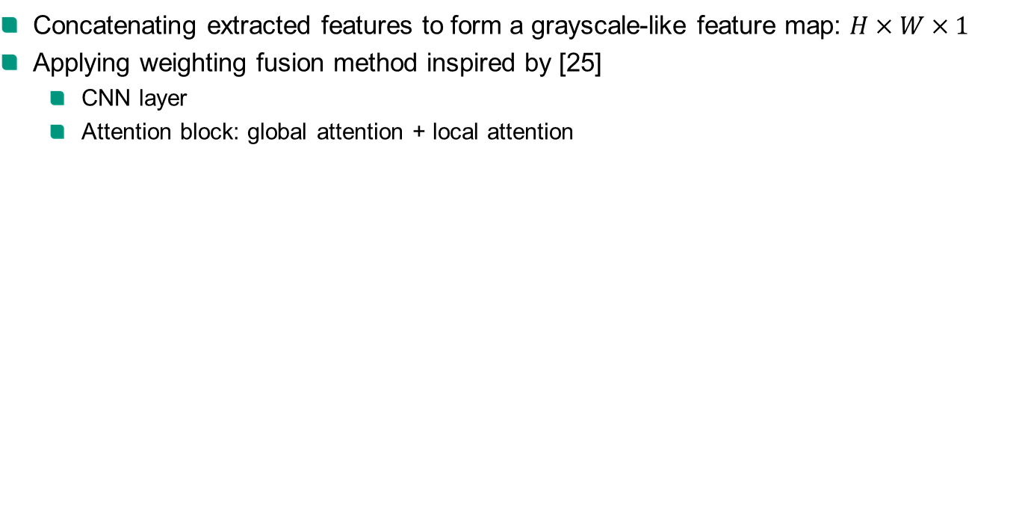
Model – Attentional Fusion Layer
Concatenating extracted features to form a grayscale-like feature map: $H×W×1$
Applying weighting fusion method inspired by [25]
CNN layer
Attention block: global attention + local attention

Slide 17
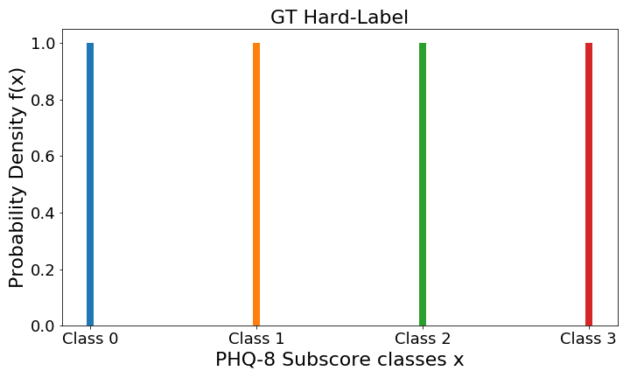
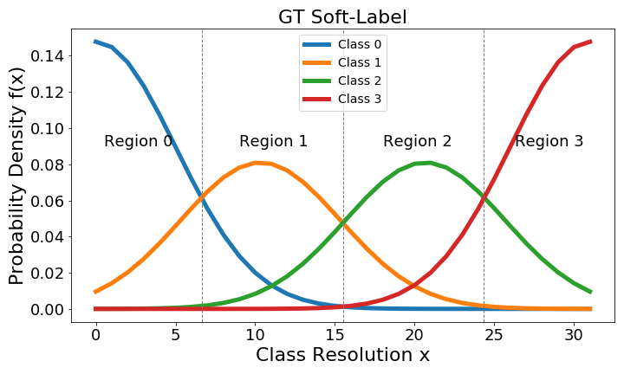
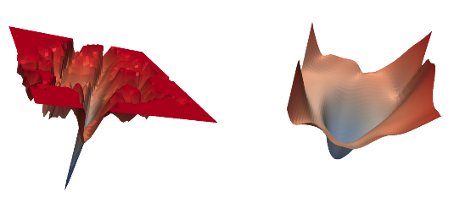

Model – Loss Function and Optimizer
Loss: Converting PHQ-8 Subscores GT to soft-label for soft-decision, inspired by [24]
Cross Entropy Loss (hard-decision) vs. Kullback–Leibler divergence loss (soft-decision)
Optimizer: Applying sharpness-aware minimizer (SAM) [22] alongside Adam optimizer to improve the generalization ability of the model training on small dataset
Loss landscape without SAM
Loss landscape with SAM

Slide 18
Experiment - Overall Strategy
Starting with single modality, training on clipped dataset
Which prediction score is better?
Which input data works better?
Which is the most effective backbone as feature extractor?
Which decision strategy is better? soft-decision vs hard-decision
Continuing with multimodality by applying transfer learning, also with clipped dataset
Which fusion method is most effective?
Firstly, training only the fusion layer and classification head
Later, fine-tuning the multi-modal model backbone
Input
Models
Output Head
Loss
Optimizer
Visual
ST-GCN
ConvBiLSTM
PHQ-Subscores
KL Divergence
SAM
Audio
Swin-S
ConvLSTM
PHQ-Score
Cross Entropy
Text
PHQ-Binary

Slide 19
Experiment – Single Modality – Audio Analysis
Modality | Data type | Backbone | Output head | soft-decision | Accuracy %
Which prediction score is better?
Audio | Mel Spectrogram | Conv1D-BiLSTM | PHQ-Subscores | No | 76.53
Audio | Mel Spectrogram | Conv1D-BiLSTM | PHQ-Score | No | 64.69
Audio | Mel Spectrogram | Conv1D-BiLSTM | PHQ-Binary | No | 63.67
Which is the most effective model as feature extractor?
Audio | Mel Spectrogram | Swin-S | PHQ-Subscores | No | 51.84
Audio | Mel Spectrogram | Swin-S | PHQ-Score | No | 31.02
Audio | Mel Spectrogram | Swin-S | PHQ-Binary | No | failed
Which decision strategy is better? + Impact of audio gender balancing (GB)
Audio | Mel Spectrogram + No GB | Conv1D-BiLSTM | PHQ-Subscores | No | 70.00
Audio | Mel Spectrogram | Conv1D-BiLSTM | PHQ-Subscores | No | 76.53
Audio | Mel Spectrogram | Conv1D-BiLSTM | PHQ-Subscores | Yes | 76.73

Slide 20
Experiment – Single Modality – Visual & Text Analysis
Modality | Data type | Backbone | Output head | soft-decision | Accuracy %
Which prediction score is better?
Visual | KPs + Gaze | Conv2D-BiLSTM | PHQ-Subscores | No | 76.94
Visual | KPs + Gaze | Conv2D-BiLSTM | PHQ-Score | No | 51.22
Visual | KPs + Gaze | Conv2D-BiLSTM | PHQ-Binary | No | 71.63
Which input data works better?
Visual | KPs + Gaze | ST-GCN | PHQ-Subscores | No | 55.71
Visual | KPs-39 + Gaze | ST-GCN | PHQ-Subscores | No | 43.67
Which decision strategy is better?
Visual | KPs + Gaze | Conv2D-BiLSTM | PHQ-Subscores | No | 76.94
Visual | KPs + Gaze | Conv2D-BiLSTM | PHQ-Subscores | Yes | 79.59
Modality | Data type | Backbone | Output head | soft-decision | Accuracy %
Which decision strategy is better?
Text | SentEmbed (dim 512) | Conv1D-BiLSTM | PHQ-Subscores | No | 50.82
Text | SentEmbed (dim 512) | Conv1D-BiLSTM | PHQ-Subscores | Yes | 46.33

Slide 21
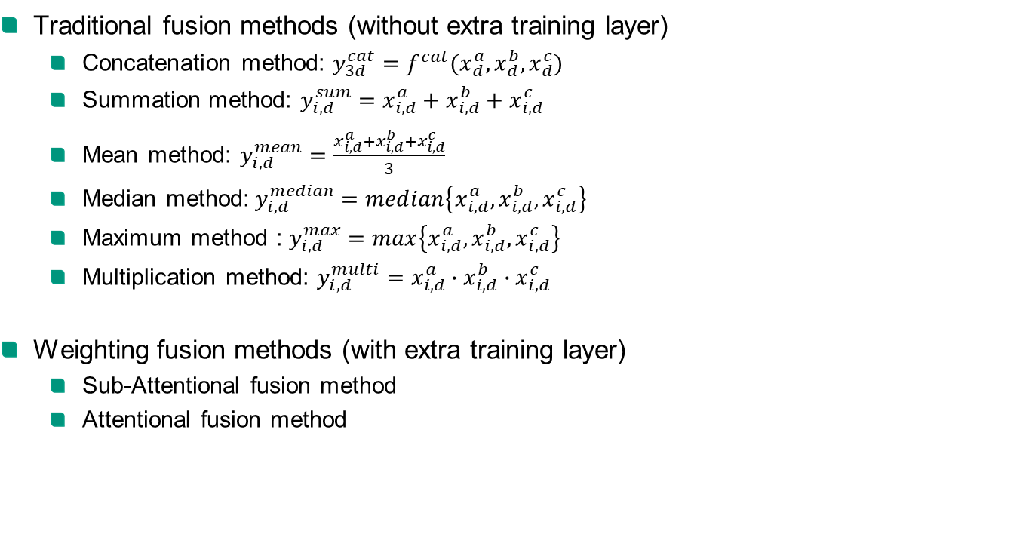
Experiment – Multimodality
Traditional fusion methods (without extra training layer)
Concatenation method: $y_{3d}^{cat}=f^{cat}(x_{d}^{a},x_{d}^{b},x_{d}^{c})$
Summation method: $y_{i,d}^{sum}=x_{i,d}^{a}+x_{i,d}^{b}+x_{i,d}^{c}$
Mean method: $y_{i,d}^{mean}=\frac{x_{i,d}^{a}+x_{i,d}^{b}+x_{i,d}^{c}}{3}$
Median method:$y_{i,d}^{median}=median\left\{x_{i, d}^{a},x_{i,d}^{b},x_{i, d}^{c}\right\}$
Maximum method : $y_{i,d}^{max}=max\left\{x_{i, d}^{a},x_{i,d}^{b},x_{i, d}^{c}\right\}$
Multiplication method: $y_{i,d}^{multi}=x_{i,d}^{a}∙x_{i,d}^{b}∙x_{i,d}^{c}$
Weighting fusion methods (with extra training layer)
Sub-Attentional fusion method
Attentional fusion method

Slide 22
Experiment – Multimodality – AV Analysis
Overall, muti-modal feature fusion increase the model performance
Single-modal audio model: Acc: 76.73%
Single-modal visual model: Acc: 79.59%
Weighting fusion methods better than traditional fusion methods
Modality | Data type | Fusion method | Output head | soft-decision | Accuracy %
Which fusion method is most effective?
Audio + Visual | Mel + (KPs + Gaze) | Concatenate | PHQ-Subscores | Yes | 79.80
Audio + Visual | Mel + (KPs + Gaze) | Sum | PHQ-Subscores | Yes | 81.43
Audio + Visual | Mel + (KPs + Gaze) | Mean | PHQ-Subscores | Yes | 81.02
Audio + Visual | Mel + (KPs + Gaze) | Median | PHQ-Subscores | Yes | 80.2
Audio + Visual | Mel + (KPs + Gaze) | Max | PHQ-Subscores | Yes | 80.82
Audio + Visual | Mel + (KPs + Gaze) | Multi | PHQ-Subscores | Yes | 79.80
Audio + Visual | Mel + (KPs + Gaze) | Attention | PHQ-Subscores | No | 82.04
Audio + Visual | Mel + (KPs + Gaze) | Sub-Attention | PHQ-Subscores | Yes | 82.04

Slide 23
Experiment – Multimodality – AVT Analysis
Performance improvement around 0.5 – 1 % by fusing text features
Best multi-modal model performance
Audio+Visual+Text: Sub-Attentional ConvBiLSTM, Acc: 82.65%
Audio+Visual: Attentional ConvBiLSTM, Acc: 82.04%
Modality | Data type | Fusion method | Output head | soft-decision | Accuracy %
Which fusion method is most effective?
Audio + Visual + Text | Mel + (KPs + Gaze) + SentEmbed | Concatenate | PHQ-Subscores | Yes | 80.82
Audio + Visual + Text | Mel + (KPs + Gaze) + SentEmbed | Sum | PHQ-Subscores | Yes | 81.22
Audio + Visual + Text | Mel + (KPs + Gaze) + SentEmbed | Mean | PHQ-Subscores | Yes | 80.00
Audio + Visual + Text | Mel + (KPs + Gaze) + SentEmbed | Median | PHQ-Subscores | Yes | 82.04
Audio + Visual + Text | Mel + (KPs + Gaze) + SentEmbed | Max | PHQ-Subscores | Yes | 81.22
Audio + Visual + Text | Mel + (KPs + Gaze) + SentEmbed | Multi | PHQ-Subscores | Yes | 80.00
Audio + Visual + Text | Mel + (KPs + Gaze) + SentEmbed | Attention | PHQ-Subscores | Yes | 82.25
Audio + Visual + Text | Mel + (KPs + Gaze) + SentEmbed | Sub-Attention | PHQ-Subscores | Yes | 82.65

Slide 24
Ablation Study – Gender Analysis
Algorithm was created to categorize the clips based on gender GT
Without gender balancing technique → strong gender bias (imbalance predicted Acc)
With gender balancing technique → Reduction of gender bias around 7.3%
Visual modality → no gender bias problem
Fusing more different modalities → lower gender bias phenomenon
■ Gender Analysis | Modality | Acc % | Female - Acc % | Male - Acc % | Difference %
ConvBiLSTM | A (No GB) | 70.00 | 64.44 | 77.67 | 13.23
ConvBiLSTM | A | 76.73 | 79.23 | 73.3 | 5.93
ConvBiLSTM | V | 79.59 | 79.93 | 79.13 | 0.80
Attentional ConvBiLSTM | AV | 82.04 | 80.63 | 83.98 | 3.35
Sub-Attentional ConvBiLSTM | AVT | 82.65 | 82.39 | 82.04 | 0.35

Slide 25
Ablation Study – Participant Analysis
So far, the model trained on clipped dataset → predicting the depression of clips
Sub-Attentional ConvBiLSTM (AVT): Acc: 82.65%
Attentional ConvBiLSTM (AV) : Acc: 82.04%
Is this result representative enough?
Algorithm was created to recombine the clips into each participant based on each ID
Overall low tolerance between both accuracies → yes, representative
Leading even to better performance
Not always shows depression symptoms over the interview
Correction of ambiguous clips through recombination
■ Participant Analysis | Modality | Clipped data - Acc % | Participant - Acc % | Improvement %
ConvBiLSTM | A (No GB) | 70.00 | 70.21 | 0.21
ConvBiLSTM | A | 76.73 | 78.72 | 1.99
ConvBiLSTM | V | 79.59 | 78.72 | -0.87
Attentional ConvBiLSTM | AV | 82.04 | 80.85 | -1.19
Sub-Attentional ConvBiLSTM | AVT | 82.65 | 85.11 | 2.46
Notes:
Tolerance less than 3%

Slide 26
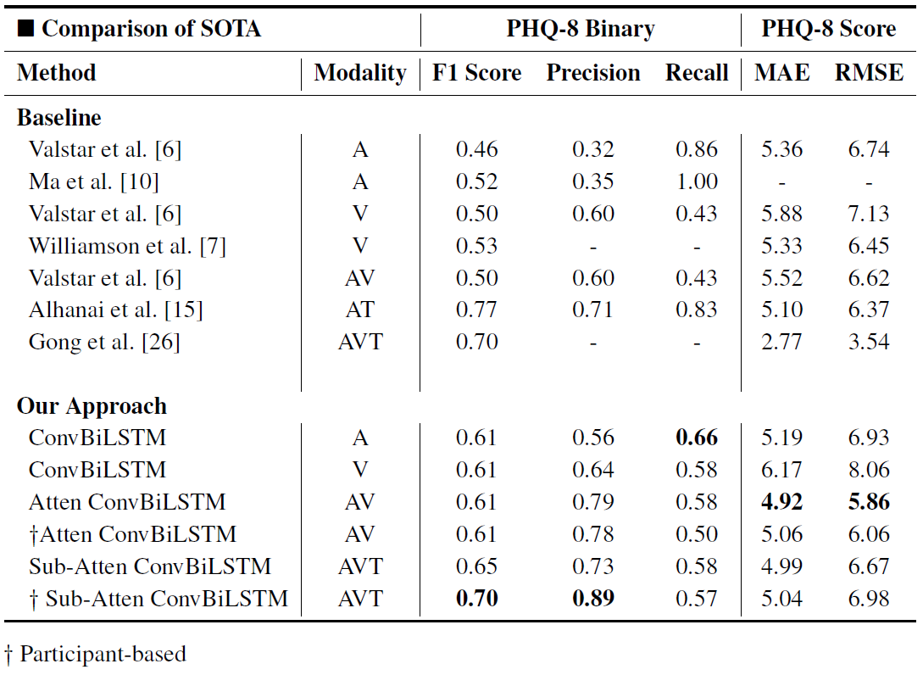
Comparison of SOTA

Slide 27
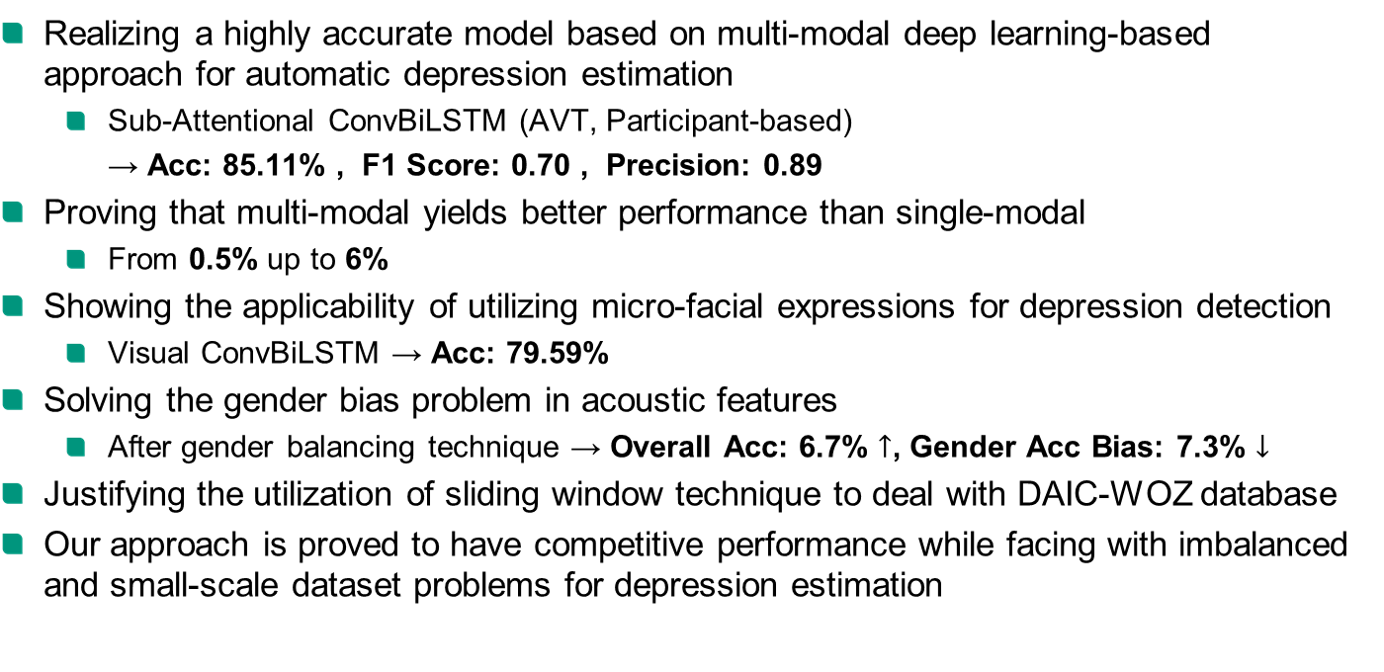
Conclusion
Realizing a highly accurate model based on multi-modal deep learning-based approach for automatic depression estimation
Sub-Attentional ConvBiLSTM (AVT, Participant-based)
→ Acc: 85.11% , F1 Score: 0.70 , Precision: 0.89
Proving that multi-modal yields better performance than single-modal
From 0.5% up to 6%
Showing the applicability of utilizing micro-facial expressions for depression detection
Visual ConvBiLSTM → Acc: 79.59%
Solving the gender bias problem in acoustic features
After gender balancing technique → Overall Acc: 6.7% $↑$, Gender Acc Bias: 7.3% $↓$
Justifying the utilization of sliding window technique to deal with DAIC-WOZ database
Our approach is proved to have competitive performance while facing with imbalanced and small-scale dataset problems for depression estimation

Slide 28
Thank you very much for your attention
Q&A

Slide 29
Bibliography
Depression key facts. World Health Organization, Sep. 2021, Retrieved from WHO official website: https://www.who.int/news-room/fact-sheets/detail/depression [1]
Schrift, AA and Notfall, Hilfsangebote im. Zahlen und fakten. [2]
Jacobi, Frank, Wittchen, H-U, H¨olting, Christoph, H¨ofler, Michael, Pfister, Hildegard, Müller, Norbert, and Lieb, Roselind. Prevalence, co-morbidity and correlates of mental disorders in the general population: results from the german health interview and examination survey (ghs). Psychological medicine, 34(4):597–611, 2004. [3]
Detbun, Piyaphat. Symptome einer Depression. Website: dreamstime.com [4]
Dham, Shubham, Sharma, Anirudh, and Dhall, Abhinav. Depression scale recognition from audio, visual and text analysis. arXiv preprint arXiv:1709.05865, 2017. [5]
Valstar, Michel, Gratch, Jonathan, Schuller, Bj¨orn, Ringeval, Fabien, Lalanne, Denis, Torres Torres, Mercedes, Scherer, Stefan, Stratou, Giota, Cowie, Roddy, and Pantic, Maja. Avec 2016: Depression, mood, and emotion recognition workshop and challenge. In Proceedings of the 6th international workshop on audio/visual emotion challenge, pages 3–10, 2016. [6]
Williamson, James R, Godoy, Elizabeth, Cha, Miriam, Schwarzentruber, Adrianne, Khorrami, Pooya, Gwon, Youngjune, Kung, Hsiang-Tsung, Dagli, Charlie. Detecting depression using vocal, facial and semantic communication cues. In Proceedings of the 6th International Workshop on Audio/Visual Emotion Challenge, pages11–18, 2016. [7]
Haque, Albert, Guo, Michelle, Miner, Adam S, and Fei-Fei, Li. Measuring depression symptom severity from spoken language and 3d facial expressions. arXiv preprint arXiv:1811.08592, 2018. [8]
Saidi, Afef, Othman, Slim Ben, and Saoud, Slim Ben. Hybrid cnn-svm classifier for efficient depression detection system. In 2020 4th International Conference on Advanced Systems and Emergent Technologies (IC_ASET), pages 229–234. IEEE, 2020. [9]

Slide 30
Bibliography
Ma, Xingchen, Yang, Hongyu, Chen, Qiang, Huang, Di, and Wang, Yunhong. Depaudionet: An efficient deep model for audio based depression classification. In Proceedings of the 6th international workshop on audio/visual emotion challenge, pages 35–42, 2016. [10]
Zhao, Yan, Liang, Zhenlin, Du, Jing, Zhang, Li, Liu, Chengyu, and Zhao, Li. Multi-head attention-based long short-term memory for depression detection from speech. Frontiers in Neurorobotics, page 111, 2021. [11]
Lam, Genevieve, Dongyan, Huang, and Lin, Weisi. Context-aware deep learning for multimodal depression detection. In ICASSP 2019-2019 IEEE International Conference on Acoustics, Speech and Signal Processing (ICASSP), pages 3946–3950. IEEE, 2019. [12]
Lin, Lin, Chen, Xuri, Shen, Ying, and Zhang, Lin. Towards automatic depression detection: A bilstm/1d cnn-based model. Applied Sciences, 10(23):8701, 2020. [13]
Gratch, Jonathan, Artstein, Ron, Lucas, Gale, Stratou, Giota, Scherer, Stefan, Nazarian, Angela, Wood, Rachel, Boberg, Jill, DeVault, David, Marsella, Stacy, et al. The distress analysis interview corpus of human and computer interviews. In Proceedings of the Ninth International Conference on Language Resources and Evaluation (LREC’14), pages 3123–3128, 2014. [14]
Alhanai, Tuka, Ghassemi, Mohammad M, and Glass, James R. Detecting depression with audio/text sequence modeling of interviews. In Interspeech, pages 1716–1720, 2018. [15]
Traunmüller, Hartmut and Eriksson, Anders. The frequency range of the voice fundamental in the speech of male and female adults. Unpublished manuscript, 11, 1995. [16]
Male to Female Voice Changer. LingoJam. Website: lingojam.com [17]
Kehtarnavaz, Nasser. Digital signal processing system design: LabVIEW-based hybrid programming. Elsevier, 2011. [18]
Velardo, Valerio. Audio signal processing for ml. GitHub, Sep. 18, 2020 [Online]. [19]

Slide 31
Bibliography
Niemitalo, Olli. Hann window function and its fourier transform. Wikipedia. Accessed February 12, 2013 [Online], Feb 2013. [20]
Rolczy´nski, Rafal. Synthetic boosted automatic speech recognition. MD dissertation, Multimedia Department, Polish-Japanese Academy of Information Technology, Warsaw, Mazowieckie, 2019. [21]
Foret, Pierre, Kleiner, Ariel,Mobahi, Hossein, and Neyshabur, Behnam. Sharpness-aware minimization for efficiently improving generalization. arXiv preprint arXiv:2010.01412, 2020. [22]
Chen, Xiangning, Hsieh, Cho-Jui, and Gong, Boqing. When vision transformers outperform resnets without pre-training or strong data augmentations. arXiv preprint arXiv:2106.01548, 2021. [23]
Tang, Yansong, Ni, Zanlin, Zhou, Jiahuan, Zhang, Danyang, Lu, Jiwen, Wu, Ying, and Zhou, Jie. Uncertainty-aware score distribution learning for action quality assessment. In Proceedings of the IEEE/CVF Conference on Computer Vision and Pattern Recognition, pages 9839–9848, 2020. [24]
Dai, Yimian, Gieseke, Fabian, Oehmcke, Stefan, Wu, Yiquan, and Barnard, Kobus. Attentional feature fusion. In Proceedings of the IEEE/CVF Winter Conference on Applications of Computer Vision, pages 3560–3569, 2021. [25]
Gong, Yuan and Poellabauer, Christian. Topic modeling based multi-modal depression detection. In Proceedings of the 7th Annual Workshop on Audio/Visual Emotion Challenge, pages 69–76, 2017. [26]
Universal-Sentence-Encoder-Large. Google. Website: https://tfhub.dev/google/universal-sentence-encoder-large/5 [27]

Slide 32
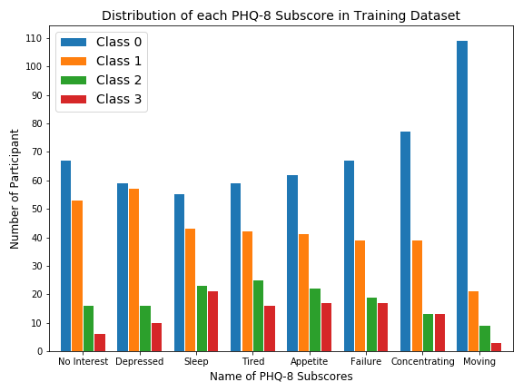
Appendix – Distribution of PHQ-8 Subscores

Slide 33
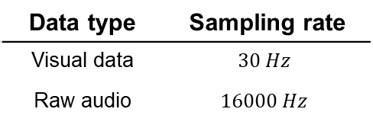



Appendix – Whole Data
Visual data:
68 2D facial landmarks
68 3D facial landmarks
Gaze direction
Head pose
Histogram of oriented gradients (HOG)
Action Units (AUs)
Audio data:
Raw audio file
COVAREP file
Formant file
Text data:
Transcription of the conversation with timestamps and speaker names
Data type | Sampling rate
Visual data | $$30 Hz$$
Raw audio | $$16000 Hz$$
Only the features from each
Participant are extracted !!!

Slide 34
Appendix – Preprocessing – Text Data
Including only the sentences from participants
Extracting timestamp – start-stop time pair
Sentence Embedding:
universal-sentence-encoder-large from Google [27]
start-stop time pair
Input Sentences
shape: n x 1
Sent2Vec
Encoder
Output Vectors
shape: n x 512

Slide 35
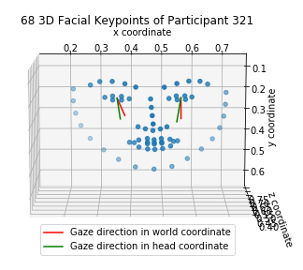
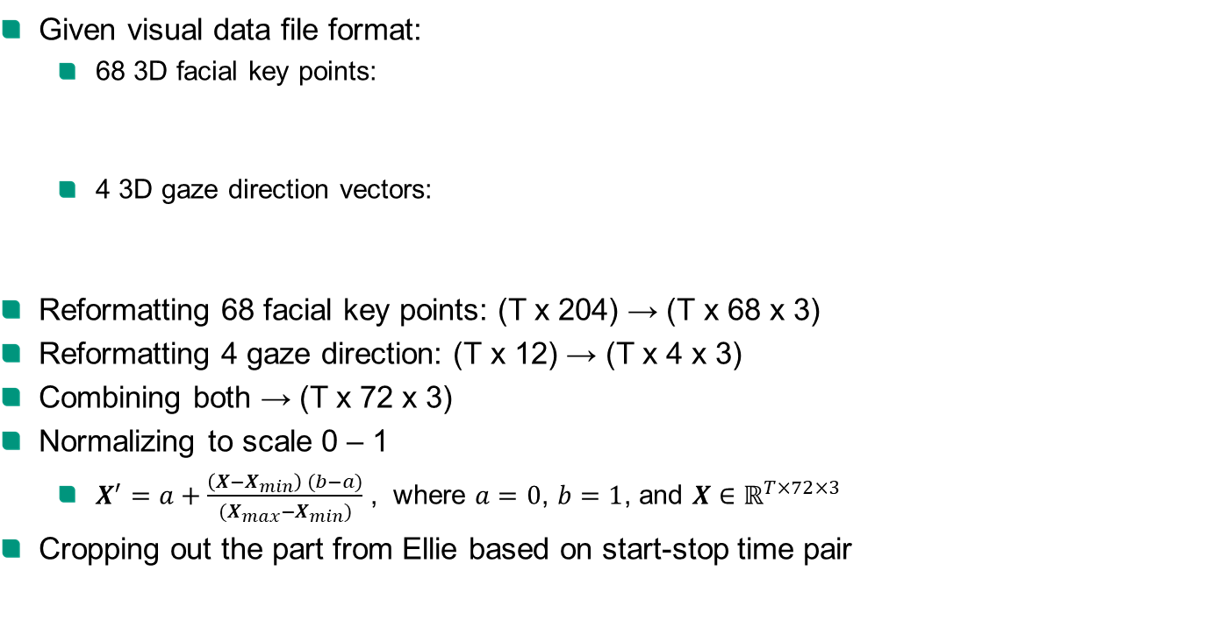
Appendix – Preprocessing – Visual Data
Given visual data file format:
68 3D facial key points:
4 3D gaze direction vectors:
Reformatting 68 facial key points: (T x 204) → (T x 68 x 3)
Reformatting 4 gaze direction: (T x 12) → (T x 4 x 3)
Combining both → (T x 72 x 3)
Normalizing to scale 0 – 1
$X^{′}=a+\frac{\left(X−X_{min}\right) (b−a)}{(X_{max}−X_{min})}$ , where $a=0$, $b=1$, and $X∈ℝ^{T×72×3}$
Cropping out the part from Ellie based on start-stop time pair
Frame | X0 | X1 | … | X67 | Y0 | Y1 | … | Y67 | Z0 | Z1 | … | Z67
11730 | -142.2 | -142.5 | … | -67.6 | -72.1 | -51.5 | … | 4.2 | 565.9 | 569.6 | … | 505.5
Frame | x_0 | y_0 | z_0 | x_1 | y_1 | z_1 | x_h0 | y_h0 | z_h0 | x_h1 | y_h1 | z_h1
11730 | 0.17 | 0.28 | -0.95 | -0.03 | 0.38 | -0.92 | 0.08 | 0.38 | -0.92 | -0.11 | 0.49 | -0.86

Slide 36
Appendix – Preprocessing – Audio Data
Problems:
Acoustic noise
Bleed-over of the voice from Ellie
Interruption during the interview
irrelevant interaction
Solution:
Clipping the signal to include only the part from the participant based on start-stop time pair

Slide 37
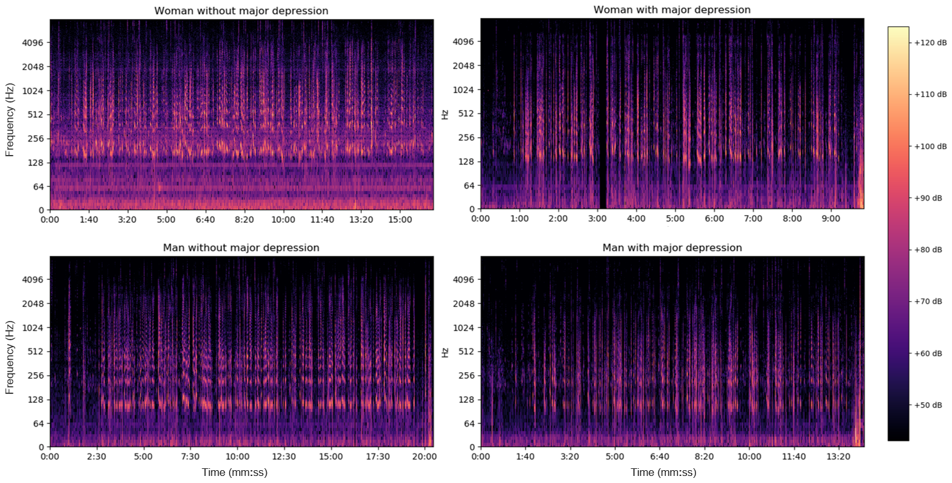
Appendix – Audio Data
Transform raw audio signal to more informative data format → Spectrogram
Problem: acoustic difference of fundamental frequency between each gender [16]
Female 210 Hz
Male 120 Hz
Notes:
The first idea is spectrogram

Slide 38
Appendix – Audio Data
Transform raw audio signal to more informative data format → Spectrogram
Problem: Woman with MD resembles man without MD
Female 210 Hz
Male 120 Hz
Notes:
The first idea is spectrogram

Slide 39
Appendix – Audio Data
Solution:
Extracting mel spectrogram instead of spectrogram for the whole dataset
Exploiting online software tool [17] to convert a voice to contrary gender for gender balancing and generating a new audio dataset

Slide 40
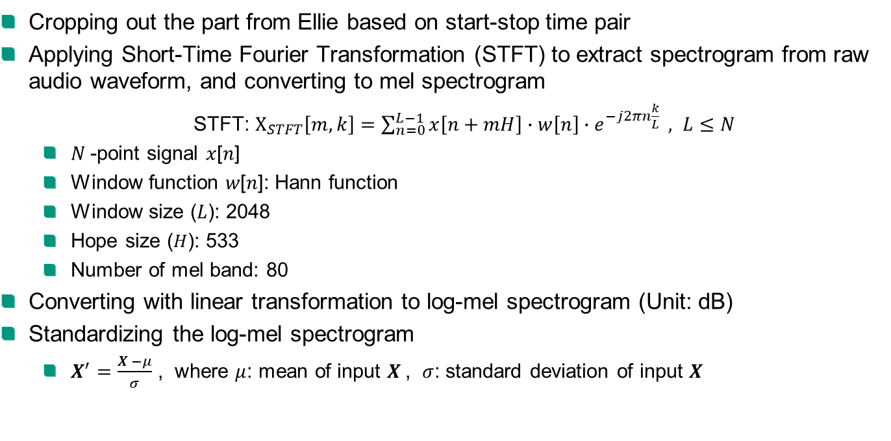
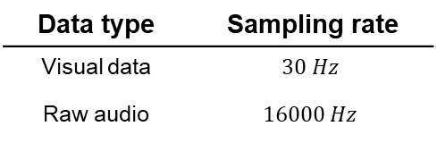
Appendix – Audio Data
Cropping out the part from Ellie based on start-stop time pair
Applying Short-Time Fourier Transformation (STFT) to extract spectrogram from raw audio waveform, and converting to mel spectrogram
STFT: $Χ_{STFT}\left[m, k\right]=\sum_{n=0}^{L−1}{x\left[n+mH\right]∙w\left[n\right]∙e^{−j2πn\frac{k}{L}} }, L≤N$
$N$-point signal 𝑥[𝑛]
Window function 𝑤[𝑛]: Hann function
Window size ($L$): 2048
Hope size ($H$): 533
Number of mel band: 80
Converting with linear transformation to log-mel spectrogram (Unit: dB)
Standardizing the log-mel spectrogram
$X^{′}=\frac{X −μ}{σ}$ , where $μ$: mean of input $X$, $σ$: standard deviation of input $X$
Data type | Sampling rate
Visual data | $$30 Hz$$
Raw audio | $$16000 Hz$$

Slide 41
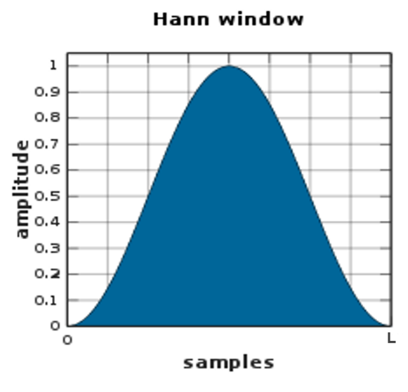
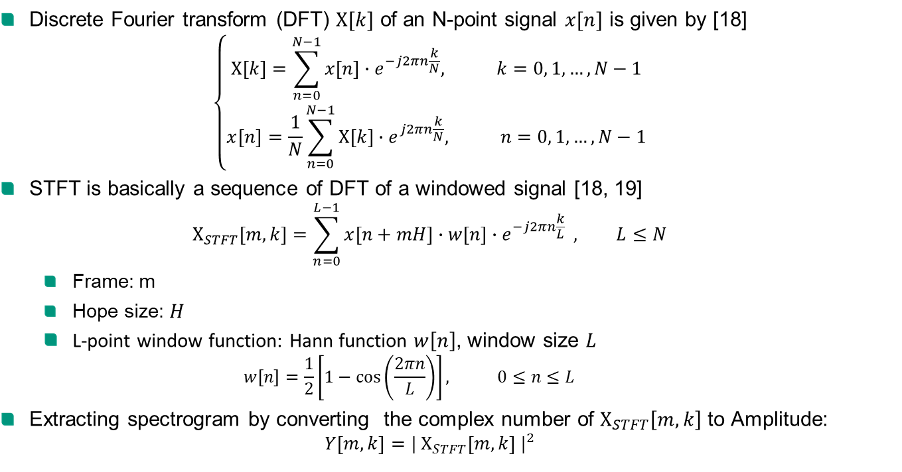
Appendix – Short-Time Fourier Transformation (STFT)
Discrete Fourier transform (DFT) $Χ[k]$ of an N-point signal $x[n]$ is given by [18]
$$\left\{\begin{aligned}Χ\left[k\right]=\sum_{n=0}^{N−1}{x\left[n\right]∙e^{−j2πn\frac{k}{N}}, k=0, 1, …, N−1} \\ x\left[n\right]=\frac{1}{N}\sum_{n=0}^{N−1}{Χ\left[k\right]∙e^{j2πn\frac{k}{N}}, n=0, 1, …, N−1}\end{aligned}\right.$$
STFT is basically a sequence of DFT of a windowed signal [18, 19]
$$Χ_{STFT}\left[m, k\right]=\sum_{n=0}^{L−1}{x\left[n+mH\right]∙w\left[n\right]∙e^{−j2πn\frac{k}{L}} }, L≤N$$
Frame: m
Hope size: $H$
L-point window function: Hann function $w\left[n\right]$, window size $L$
$$w\left[n\right]=\frac{1}{2}\left[1−\cos\left(\frac{2πn}{L}\right)\right], 0≤n≤L$$
Extracting spectrogram by converting the complex number of $Χ_{STFT}\left[m, k\right]$ to Amplitude:
$$Y\left[m, k\right]={|{ Χ}_{STFT}\left[m, k\right] |}^{2}$$
[20]

Slide 42
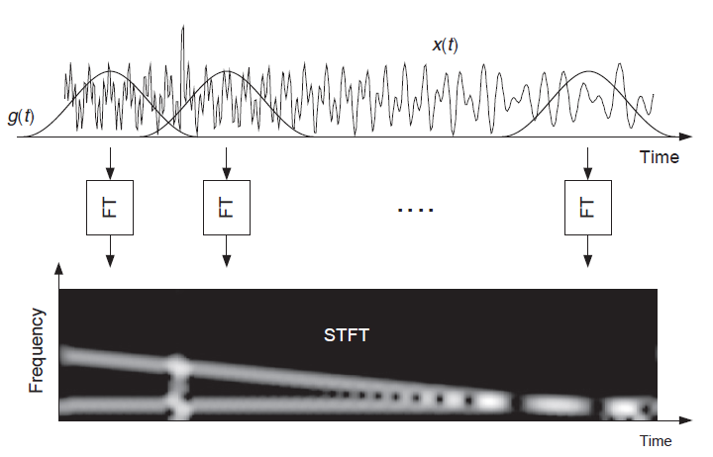
Appendix – Short-Time Fourier Transformation (STFT)
m=1
m=2
m=n
[18]

Slide 43
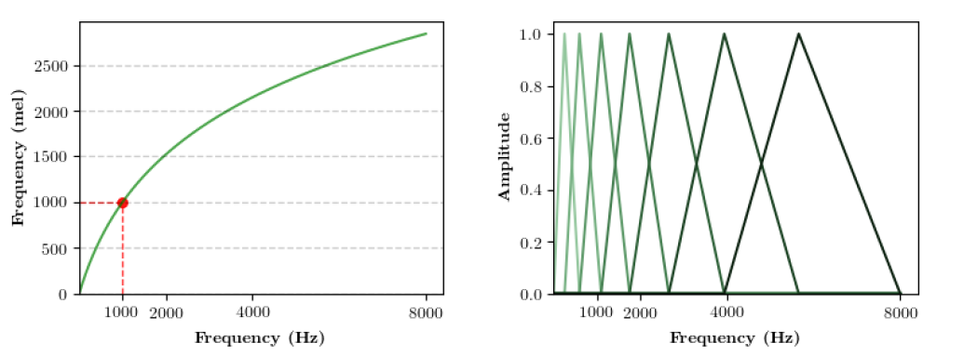
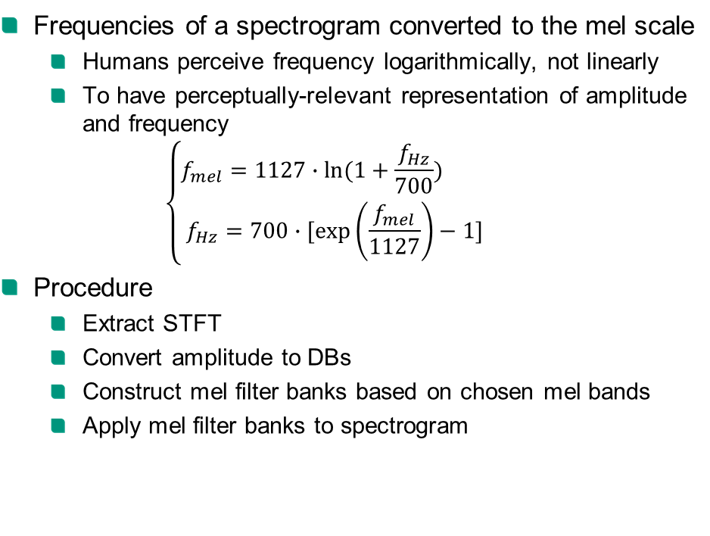
Appendix – Mel Spectrogram
Frequencies of a spectrogram converted to the mel scale
Humans perceive frequency logarithmically, not linearly
To have perceptually-relevant representation of amplitude and frequency
$$\left\{\begin{aligned}f_{mel}=1127∙ln⁡(1+\frac{f_{Hz}}{700}) \\ f_{Hz}=700∙[\exp\left(\frac{f_{mel}}{1127}\right)−1]\end{aligned}\right.$$
Procedure
Extract STFT
Convert amplitude to DBs
Construct mel filter banks based on chosen mel bands
Apply mel filter banks to spectrogram
[21]

Slide 44
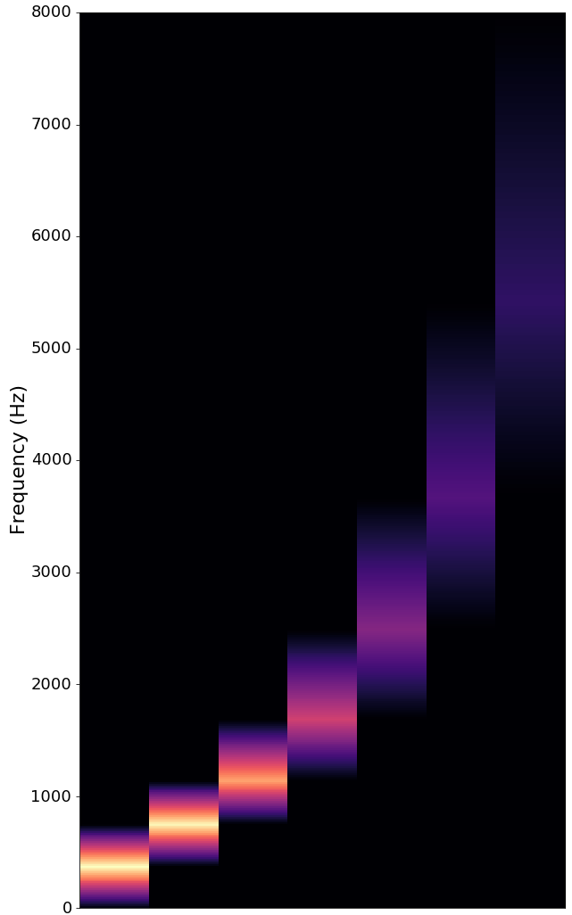
Appendix – Mel Spectrogram

Slide 45

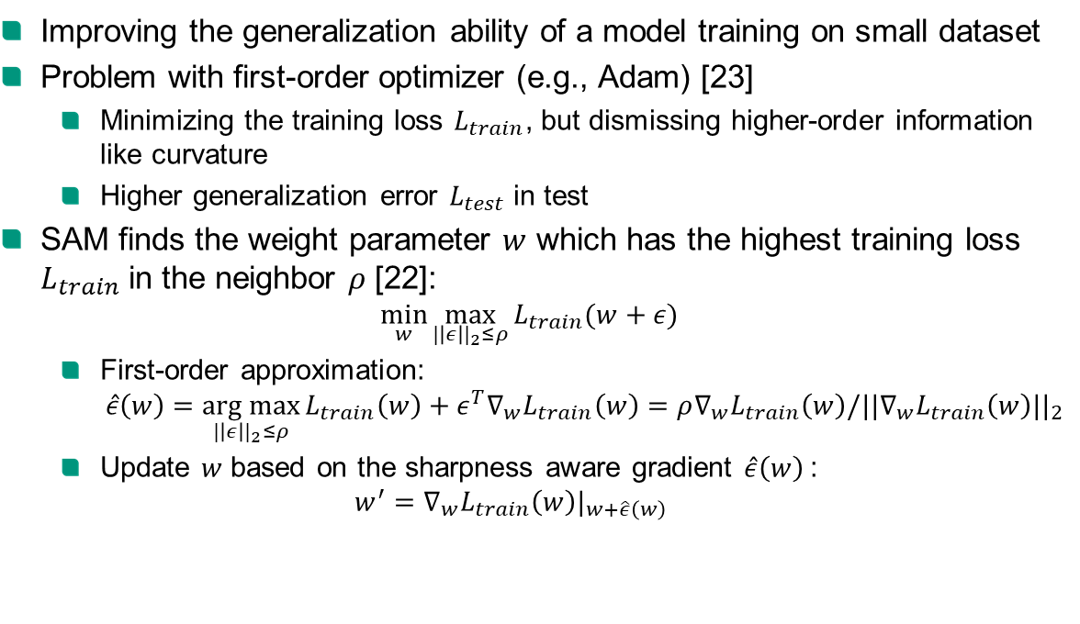
Appendix – Sharpness-Aware Minimization (SAM)
Improving the generalization ability of a model training on small dataset
Problem with first-order optimizer (e.g., Adam) [23]
Minimizing the training loss $L_{train}$, but dismissing higher-order information like curvature
Higher generalization error $L_{test}$ in test
SAM finds the weight parameter $w$ which has the highest training loss $L_{train}$ in the neighbor $ρ$ [22]:
$$\min_{w}{\max_{|\left|ε\right||_{2}≤ρ}{L_{train}(w+ε)}}$$
First-order approximation:
$$\hat{ε}\left(w\right)=\underset{|\left|ε\right||_{2}≤ρ}{arg max}{L_{train}\left(w\right)+ε^{T}∇_{w}L_{train}\left(w\right)}=ρ∇_{w}L_{train}\left(w\right)/||∇_{w}L_{train}\left(w\right)||_{2}$$
Update $w$ based on the sharpness aware gradient $\hat{ε}\left(w\right)$:
$$w^{′}=∇_{w}L_{train}\left(w\right)|_{w+\hat{ε}\left(w\right)}$$
Loss landscape
without SAM
Loss landscape
with SAM
[22]

Slide 46
Appendix – Single Modality – Audio Analysis
Modality | Data type | Backbone | Output head | soft-decision | Accuracy %
Which prediction score is better?
Audio | Mel Spectrogram | Conv1D-BiLSTM | PHQ-Subscores | No | 76.53
Audio | Mel Spectrogram | Conv1D-BiLSTM | PHQ-Score | No | 64.69
Audio | Mel Spectrogram | Conv1D-BiLSTM | PHQ-Binary | No | 63.67
Which input data works better?
Audio | Spectrogram | Conv1D-BiLSTM | PHQ-Subscores | No | 69.80
Audio | Spectrogram | Conv1D-BiLSTM | PHQ-Score | No | 45.51
Audio | Spectrogram | Conv1D-BiLSTM | PHQ-Binary | No | 45.31
Which is the most effective model as feature extractor?
Audio | Mel Spectrogram | Swin-S | PHQ-Subscores | No | 51.84
Audio | Mel Spectrogram | Swin-S | PHQ-Score | No | 31.02
Audio | Mel Spectrogram | Swin-S | PHQ-Binary | No | failed
Which decision strategy is better? + Impact of audio gender balancing (GB)
Audio | Mel Spectrogram + No GB | Conv1D-BiLSTM | PHQ-Subscores | No | 70.00
Audio | Mel Spectrogram | Conv1D-BiLSTM | PHQ-Subscores | No | 76.53
Audio | Mel Spectrogram | Conv1D-BiLSTM | PHQ-Subscores | Yes | 76.73

Slide 47
Appendix – Single Modality – Visual & Text Analysis
Modality | Data type | Backbone | Output head | soft-decision | Accuracy %
Which prediction score is better?
Visual | KPs + Gaze | Conv2D-BiLSTM | PHQ-Subscores | No | 76.94
Visual | KPs + Gaze | Conv2D-BiLSTM | PHQ-Score | No | 51.22
Visual | KPs + Gaze | Conv2D-BiLSTM | PHQ-Binary | No | 71.63
Which input data works better?
Visual | KPs + Gaze | ST-GCN | PHQ-Subscores | No | 55.71
Visual | KPs-39 + Gaze | ST-GCN | PHQ-Subscores | No | 43.67
Which decision strategy is better?
Visual | KPs + Gaze | Conv2D-BiLSTM | PHQ-Subscores | No | 76.94
Visual | KPs + Gaze | Conv2D-BiLSTM | PHQ-Subscores | Yes | 79.59
Modality | Data type | Backbone | Output head | soft-decision | Accuracy %
Which decision strategy is better?
Text | SentEmbed (dim 512) | Conv1D-BiLSTM | PHQ-Subscores | No | 50.82
Text | SentEmbed (dim 512) | Conv1D-BiLSTM | PHQ-Subscores | Yes | 46.33

Slide 48
Appendix – Single Modality – Summary
Overall
Best output head for the best performance: PHQ-8 Subscores
Most effective model backbone: ConvBiLSTM
Better decision method: Soft-decision
Audio
Significant improvement (6.5%) by applying gender balancing technique
Text
Providing insufficient information related to depression estimation by itself
Best single-modal model performance
Audio: Conv1D-BiLSTM with soft-decision, Acc: 76.73%
Visual: Conv2D-BiLSTM with soft-decision, Acc: 79.59%
Text: fail

Slide 49
Appendix – Multimodality – Audio + Visual
Training with soft-decision generally shows better performance
Modality | Data type | Fusion method | Output head | soft-decision | Accuracy %
Which fusion method is most effective?
Audio + Visual | Mel + (KPs + Gaze) | Concatenate | PHQ-Subscores | No | 79.59
Audio + Visual | Mel + (KPs + Gaze) | Concatenate | PHQ-Subscores | Yes | 79.8
Audio + Visual | Mel + (KPs + Gaze) | Sum | PHQ-Subscores | No | 80.82
Audio + Visual | Mel + (KPs + Gaze) | Sum | PHQ-Subscores | Yes | 81.43
Audio + Visual | Mel + (KPs + Gaze) | Mean | PHQ-Subscores | No | 81.22
Audio + Visual | Mel + (KPs + Gaze) | Mean | PHQ-Subscores | Yes | 81.02
Audio + Visual | Mel + (KPs + Gaze) | Median | PHQ-Subscores | No | 79.8
Audio + Visual | Mel + (KPs + Gaze) | Median | PHQ-Subscores | Yes | 80.2
Audio + Visual | Mel + (KPs + Gaze) | Max | PHQ-Subscores | No | 80.41
Audio + Visual | Mel + (KPs + Gaze) | Max | PHQ-Subscores | Yes | 80.82
Audio + Visual | Mel + (KPs + Gaze) | Multi | PHQ-Subscores | No | 79.8
Audio + Visual | Mel + (KPs + Gaze) | Multi | PHQ-Subscores | Yes | 79.8
Audio + Visual | Mel + (KPs + Gaze) | Attention | PHQ-Subscores | No | 82.04
Audio + Visual | Mel + (KPs + Gaze) | Attention | PHQ-Subscores | Yes | 81.43
Audio + Visual | Mel + (KPs + Gaze) | Sub-Attention | PHQ-Subscores | No | 81.63
Audio + Visual | Mel + (KPs + Gaze) | Sub-Attention | PHQ-Subscores | Yes | 82.04

Slide 50
Appendix – Multimodality – Audio + Visual + Text
Performance improvement around 0.5 – 1 %
Training with soft-decision generally shows better performance
Modality | Data type | Fusion method | Output head | soft-decision | Accuracy %
Which fusion method is most effective?
Audio + Visual + Text | Mel + (KPs + Gaze) + SentEmbed | Concatenate | PHQ-Subscores | No | 80
Audio + Visual + Text | Mel + (KPs + Gaze) + SentEmbed | Concatenate | PHQ-Subscores | Yes | 80.82
Audio + Visual + Text | Mel + (KPs + Gaze) + SentEmbed | Sum | PHQ-Subscores | No | 80.82
Audio + Visual + Text | Mel + (KPs + Gaze) + SentEmbed | Sum | PHQ-Subscores | Yes | 81.22
Audio + Visual + Text | Mel + (KPs + Gaze) + SentEmbed | Mean | PHQ-Subscores | No | 81.63
Audio + Visual + Text | Mel + (KPs + Gaze) + SentEmbed | Mean | PHQ-Subscores | Yes | 80
Audio + Visual + Text | Mel + (KPs + Gaze) + SentEmbed | Median | PHQ-Subscores | No | 81.63
Audio + Visual + Text | Mel + (KPs + Gaze) + SentEmbed | Median | PHQ-Subscores | Yes | 82.04
Audio + Visual + Text | Mel + (KPs + Gaze) + SentEmbed | Max | PHQ-Subscores | No | 80.61
Audio + Visual + Text | Mel + (KPs + Gaze) + SentEmbed | Max | PHQ-Subscores | Yes | 81.22
Audio + Visual + Text | Mel + (KPs + Gaze) + SentEmbed | Multi | PHQ-Subscores | No | 80.41
Audio + Visual + Text | Mel + (KPs + Gaze) + SentEmbed | Multi | PHQ-Subscores | Yes | 80
Audio + Visual + Text | Mel + (KPs + Gaze) + SentEmbed | Attention | PHQ-Subscores | No | 81.22
Audio + Visual + Text | Mel + (KPs + Gaze) + SentEmbed | Attention | PHQ-Subscores | Yes | 82.25
Audio + Visual + Text | Mel + (KPs + Gaze) + SentEmbed | Sub-Attention | PHQ-Subscores | No | 82.04
Audio + Visual + Text | Mel + (KPs + Gaze) + SentEmbed | Sub-Attention | PHQ-Subscores | Yes | 82.65

Slide 51
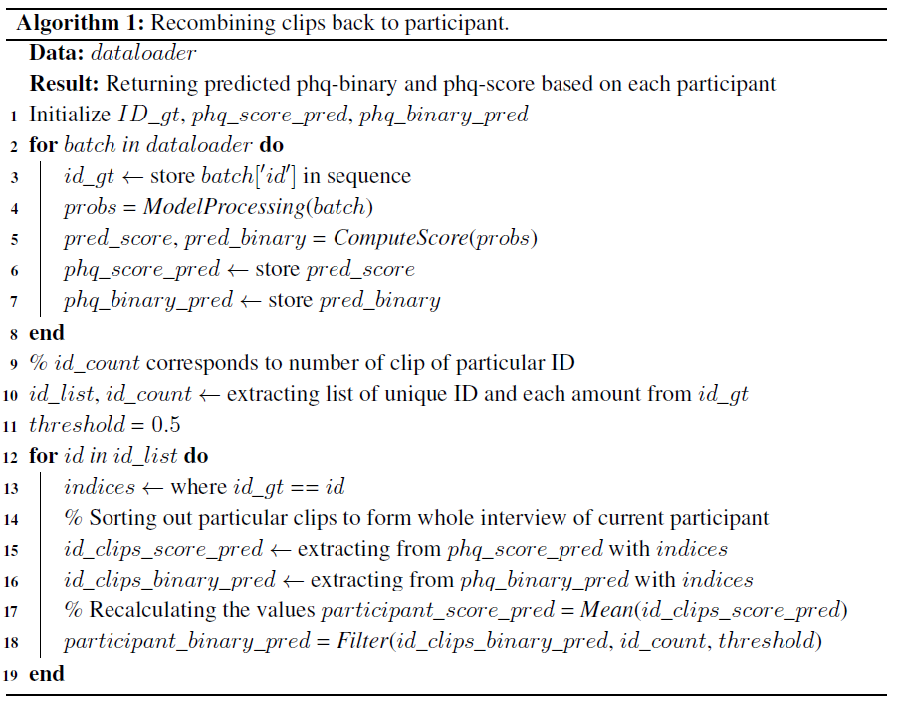
Appendix – Participant Analysis

Slide 52
Appendix – Participant Analysis
Why performance improvement in “Sub-Attentional ConvBiLSTM AVT” model?
Not always shows depression symptoms over the interview
Correction of ambiguous clips through recombination
ID | PHQ-8 GT |  | PHQ-8 Prediction |  | clip_01 | clip_02 | clip_03 | clip_04 | clip_05 | clip_06 | clip_07 | clip_08 | clip_09
 | Binary | Score | Binary | Score
P_453 | 1 | 17 | 1 | 17 | 21 | 15 | 21 | 19 | 19 | 17 | 12 | 20 | 13
P_323 | 0 | 1 | 0 | 2 | 3 | 0 | 0 | 0 | 2 | 2 | 2 | 7
P_332 | 1 | 18 | 1 | 13 | 9 | 11 | 11 | 11 | 11 | 11
P_421 | 1 | 10 | 1 | 12 | 13 | 9 | 12 | 11 | 16 | 17 | 8 | 13
P_334 | 0 | 5 | 0 | 8 | 9 | 2 | 9 | 7 | 9 | 10 | 9 | 10 | 13
P_408 | 0 | 0 | 0 | 5 | 8 | 11 | 2 | 0 | 11 | 2 | 1

